Slide 1
Business Management System Implementation Utilizing TL 9000 as a Model
October 4th, 2011
JDSU, Germantown, Maryland
Dave Sanicola
Dave.Sanicola@DesaraGroup.com
Karen Rawson
Karen.Rawson@DesaraGroup.com

Slide 2
Process Management Business Case
JDSU Current State:
40+% R&D Project FCS on Time
Poor on time delivery of customer orders
Multiple business processes and systems
Fixing the same problem multiple times
Poor forecast accuracy
Our strategic customer relationships
Ineffective management in addressing End of Manufacturing (EoM)
Time & effort to manage orders
The interconnectivity of information within our IT systems
The effort we have to spend just to survive
Source: Ken Koffmans 9/1/11 Presentation to the SMT
Notes:
We understand that improvement have been made.

Slide 3
Process Management
Establishes capability to address the cross-functional nature of business
Common processes drive better communication
Common processes allow resource sharing
Allows better scalability
Uses measurement to drive focused improvements
Allows quicker improvements and organizational learning
Drivers:
Customer satisfaction
Growth
Income
Overarching reason: Improve Performance

Slide 4
Why use TL 9000 as a Model
Strong process based approach
Developed and utilized by the Telecommunications industry
Based on ISO 9001
90+ additional requirements focused on the needs of Telecom
Software Development
Project Planning and Mananagement
Risk Assessment and Mitigation
Built in practices to assure:
Process management and improvement
Management focus on defined measures
Process adherence
Constant improvement
Industry Benchmark Data Available for:
Software performance
Hardware return rates
On time delivery
(segmented by product classification)

Slide 5
Basic Management System
Expectations
Expectations
People
Equipment
Materials
Procedures
Supplier
Customer
Input
Output
Feedback
Measurement system
Feedback
Notes:
Instructor Notes:
To fully understand a process, we have to know the inputs, outputs, controllers (measures and monitors), mechanisms, and feedback loops.
Processes are usually triggered by a customer need (could be an internal customer). Inputs come from both internal and external suppliers. Mechanisms are applied to transform inputs into outputs.
These mechanisms include:
machines
materials
manpower
methods
measurement
maintenance
management
money

Slide 6
Successful Implementation Depends on Leadership at All Levels
Business imperative for implementation
Champion / Management Commitment
Resources
Deadline that makes business sense, tied to individual annual objectives
Functional corrective action system
Business focus on
Improved communications (internally, suppliers, customers)
Data collection, analysis, and usage for performance improvement
Systematic planning and continual improvement of plans based on experience
Appropriate system scope to meet the needs of business and customers
Measurement system
Mind set:
Improve the business, not pass the audit
TL 9000 as the starting line – and there is no finish line
Knowledge Base: Internal, Corporate, or Externally Sourced
QMS implementation experience
TL 9000 Knowledge: Measurements, Adders
The SMT must fully support this initiative

Slide 7
TL 9000 Tellabs Case Study
Utilizing TL 9000 as a baseline for business improvement

Slide 8
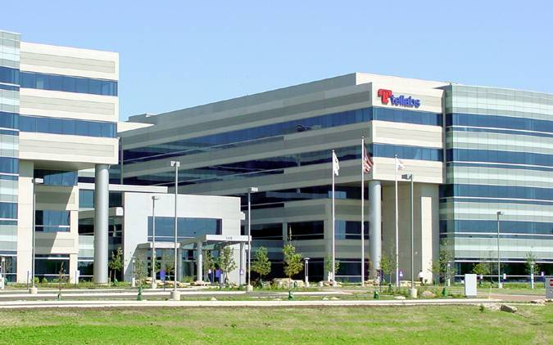
About Tellabs 2011
Established in 1975 with corporate headquarters in the Chicago area
Approximately 3,150 employees globally
Publicly listed on NASDAQ (TLAB)
2009 financial performance
$1.5 billion revenue
Strong financial foundation
$1.18 billion in cash
Zero long-term debt
Notes:
Solutions from Tellabs enable service providers to deliver high-quality voice, video and data services over wire line and wireless networks around the world.

Slide 9
























Tellabs Serves 41 of the Top 50 Wireless
and Wire-line Carriers
South Africa’s Leading Cellular Network

Slide 10
Why TL 9000 at Tellabs
Solid framework to drive improvement
Tellabs results
Measurements, management rigor and continual improvement lead to cost savings through CoPQ cut in half
Customer satisfaction
NPS (Net Promoter Score) increased
Hardware quality: 12 points
Reliability: 19 points
Overall: 15 points
HW outages reduced by 20% on transport products
But that was just the beginning
Processes baselined
TL9000 measurements in place
Data Analysis begins
Real bottom line results realized as a result of data analysis and process improvements
Notes:
Net Promoter is a customer loyalty metric developed by (and a registered trademark of) Fred Reichheld, Bain & Company, and Satmetrix. It was introduced by Reichheld in his 2003 Harvard Business Review article "The One Number You Need to Grow".^{[2]} The most important proposed benefits of this method derive from simplifying and communicating the objective of creating more "Promoters" and fewer "Detractors" — a concept claimed to be far simpler for employees to understand and act on than more complicated, obscure or hard-to-understand satisfaction metrics or indices. In addition, proponents claim the Net Promoter method can reduce the complexity of implementation and analysis frequently associated with measures of customer satisfaction, providing a stable measure of business performance that can be compared across business units and even across industries, and increasing interpretability of changes in customer satisfaction trends over time.
The Net Promoter Score is obtained by asking customers a single question on a 0 to 10 rating scale, where 10 is "extremely likely" and 0 is "not at all likely": "How likely is it that you would recommend our company to a friend or colleague?" Based on their responses, customers are categorized into one of three groups: Promoters (9–10 rating), Passives (7–8 rating), and Detractors (0–6 rating). The percentage of Detractors is then subtracted from the percentage of Promoters to obtain a Net Promoter score (NPS). NPS can be as low as -100 (everybody is a detractor) or as high as +100 (everybody is a promoter). The NPS is not a percentage but some people wrongly put a "%" sign after it, instead of correctly using "+" or "-" to show the result. An NPS that is positive (i.e., higher than zero) is felt to be good, and an NPS of +50 is excellent. Companies are encouraged to follow this question with an open-ended request for elaboration, soliciting the reasons for a customer's rating of that company or product. These reasons can then be provided to front-line employees and management teams for follow-up action.^{[3]} Local office branch managers at Charles Schwab Corporation, for example, call back customers to engage them in a discussion about the feedback they provided through the NPS survey process, solve problems, and learn more so they can coach account representatives.^{[4]}
Proponents of the Net Promoter approach claim the score can be used to motivate an organization to become more focused on improving products and services for customers. They further claim that a company's Net Promoter Score correlates with revenue growth. Discussed at length in The Ultimate Question: Driving Good Profits and True Growth by Fred Reichheld, and "Answering the Ultimate Question" by Richard Owen and Laura Brooks, the Net Promoter approach has been adopted by several companies, including E.ON, Philips, GE,^{[5]} Allianz,^{[6]} P&G,^{[7]} Intuit,^{[8]} American Express,^{[9]} and Westpac Banking Corporation. It has also emerged as a way to measure loyalty for online applications, as well as social game products.^{[10]}

Slide 11
Ongoing Tellabs Improvements
Creating predictive field failure rates utilizing TL 9000 Measurements
Utilizing TL 9000 for Effective Supply Chain Mananagement
Rapid Process Mananagement
Improving Customer Satisfaction
Creating a Demand for Business Excellence
White Papers and Presentations for these improvement initiatives are available on the QuEST Forum web site at: http://portal.questforum.org/questVer2/KnowledgeLibrary/

Slide 12
Tellabs Improvement Data
A total of over $600k savings or cost reduction and 16 weeks average improved cycle time
2010 | Global Product Lifecycles | 12.0 weeks | Reduced existing global product lifecycles from 5 to 1 | na
2010 | NE Deployment | 15.0 weeks | Developed process for validation of NE counts for key customers | na
2010 | Out of Box Returns Inventory Disposition | 19.4 weeks | Process improvement allowed unit based Vs. flat fee pricing | $512K
 |  |  | Reduced required cyle counts, reduced invalid OOB orders
 |  |  | Reduced inventory, irreparable write offs with CM's
2010 | Global Last Time Buy Approval Process | 19.2 weeks | Standardized and automated LTB approval process | $54K
2010 | Released Product Support (RPS) 7100 | 21.6 weeks | Implemented RPS processes for 7100 inclusive of CN's | na
2010 | Global Test Engineering PN and BOM | 14.0 weeks | GTE Part Number & BOM Processes for 8 to 2 | na
2010 | Global Test Engineering Lifecycles | 13.6 weeks | Aligned GTE Lifecycle to Global PRP | $55K
2010 | BT 8600 Major Outage Restoration | 13.0 weeks | Reduced time to restore from 11 hours to 3 for major cases | na
 | Average | 16 wks | Total | $621K

Slide 13
Ongoing Tellabs Improvements Business Excellence
1.7M GrMrg
1.4M Inv
1 M OPEX
2.5M OPEX
1.7M GrMrg
1.4M Inv
2.5M OPEX
1.7M GrMrg
1.4M Inv

Slide 14
A Special Thanks to Tellabs
Not may companies are willing to share real improvement data we would like to give credit to:
Dave Stahl, VP Tellabs
Ben Krupowicz, Business Improvement Champion – Tellabs
Vin Kane, Tellabs Statistician
Tellabs VP Dave Stall would be happy to discuss their improvement initiatives with any JDSU senior staff

Slide 15
TL 9000 Overview
The QuEST Forum

Slide 16
Who Wrote TL 9000, When and Why? QuEST Forum History
1997: Telecom regulators raced to increase competition
Wireless and internet technologies, new companies emerged
Market demanded speed and innovation
New companies sacrificed quality disciplines
More consumer choices
New services offered
Declining customer satisfaction
Tremendous financial losses from quality problems
Critical nature of telecom infrastructure: excellence is necessary for the public

Slide 17
QuEST Forum History, continued
Service Providers developed independent quality standards
Suppliers disliked
Incurring costs for inspection and compliance with multiple sets of rules
Conducting customer audits that were frequent, disruptive, and largely redundant
Being compared “unfairly” with competitors due to inconsistent reporting of quality data
Solution: Joint effort of Service Providers and Suppliers to develop common standards

Slide 18
QuEST Forum: Incorporated 1998
Quality
Excellence for
Suppliers of Telecommunications
Members Include: Service Providers – Global Representation Suppliers of Hardware, Software, and Services Liaisons: Accreditation Bodies, Registrars, Training Providers, Support Services
Strategic Alliances (TC 176, IAF, TMF, COMC.CASE)
Notes:
IAF: International Accreditation Forum, the world association of Conformity Assessment Accreditation Bodies in the fields of management systems, products, services, personnel and other similar programs of conformity assessment
TMF: TeleManagement Forum. The TeleManagement Forum was founded in 1988 as the OSI/Network Management Forum with the goal of accelerating the availability of interoperable network management products. Founding members included AT&T and BT on the service provider side, and suppliers such as Northern Telecom and Hewlett-Packard on the equipment side.
COMC.CACE: Communications Network Operations & Maintenance Committee - Chinese Association Communication Enterprises
CACE, is short for China Association of Communication Enterprises, was established in early 2005. “This association has promoted the IT management reform, strengthened IT service level, and exalted integrative operation ability by establishing communication and co-operation between communication enterprises and IT service manufacturer. “

Slide 19
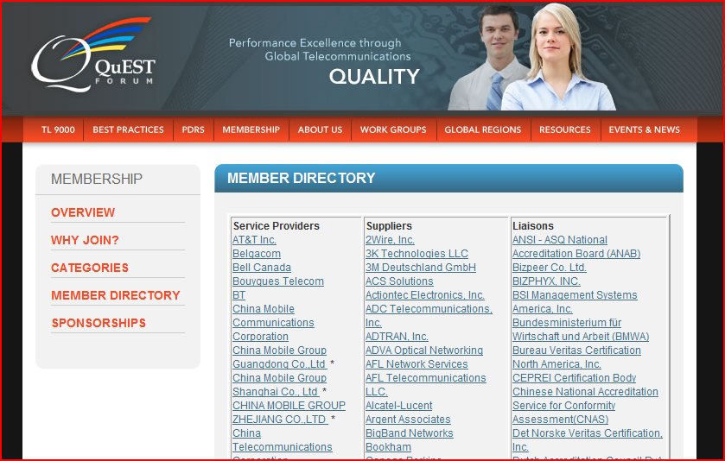
QuEST Forum members are listed on the web site
QuEST Forum meets regularly in North America, Europe, and Asia to address industry issues. Members define and approve the contents of the TL 9000 Handbooks and the administration of QuEST Forum business. Best Practices are shared in annual conferences open to the industry.

Slide 20
QuEST Forum and TL 9000
QuEST Forum released TL 9000 in 1999
TL 9000 is periodically updated by QuEST Forum
Organizations who comply with TL 9000 may seek certification through an accredited registrar. QuEST Forum controls the accreditation process for registrars and auditors to maintain consistency around the world.
TL 9000 Certified organizations are listed on the TL 9000 web site.
TL 9000 Certification is independent from QuEST Forum membership. Not all QuEST Forum members are certified, and not all certified organizations are QuEST Forum members.

Slide 21
TL 9000 Purpose Section 1, page 1-1 of TL 9000 Requirements Handbook
To define quality management system requirements specific to the telecommunications industry.
Hardware, software, and services
Covers all aspects:
Design and development
Production, delivery and installation
Maintenance
Includes all requirements of ISO 9001 and adds related requirements that pertain to the needs of our industry.
To define a set of measurements that allows evaluation of the effectiveness of the quality management system from the customers’ perspective.
Customers can compare suppliers
Organizations can benchmark and gauge progress over time
To drive continual improvement of service to subscribers and to increase competitiveness.

Slide 22
ISO 9001 / TL 9000 Comparison

Slide 23
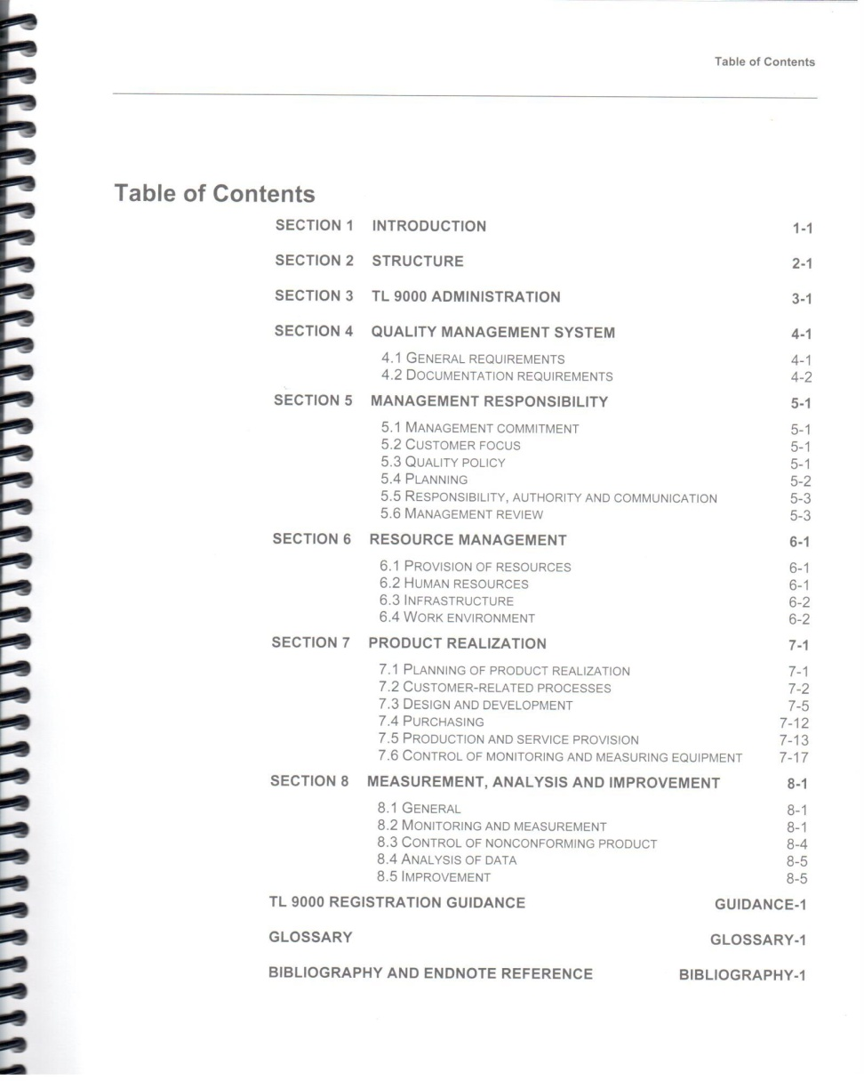

Open to TL 9000 Requirements Table of Contents

Slide 24
ISO 9001 Review of Concepts
Goals: Top Management establishes quality policy, objectives, plans, and authority; makes sure communication channels exist; reviews progress. (Section 5 – Management Responsibility)
Resources: Management ensures the business has sufficient infrastructure, work areas, and trained employees to achieve the defined objectives. (Section 6 – Resource Management)
Methods: Plan and carry out processes for taking orders, developing products, purchasing material and services, producing the product or service under controlled conditions, and using calibrated equipment where required. (Section 7 – Product Realization)
Checks: Collect and analyze data on customer satisfaction, product/service requirements fulfillment and process effectiveness. Make changes to processes to eliminate causes of problems, and ensure defects are removed. (Section 8 - Measurement, Analysis and Improvement)
Documents and Records: Document Business processes and keeps records of fulfillment of requirements. (Section 4 – Quality Management System)
Section 5 Goals
Section 8 Checks
Section 7 Methods
Section 6 Resources
Docu-ments
and Records
Customer Requirements and Feedback

Slide 25
Key Requirements of ISO 9001
Management Is Responsible For:
Understanding Customers, Markets, Competition
Defining Strategic Objectives
Setting Goals and Making Plans
Providing Money, People and Infrastructure to Support Plans
Communicating with Customers, Suppliers, and Employees
Reviewing Performance and Making Decisions to Achieve Goals
Everyone Shares Responsibility For:
Understanding Objectives and Requirements
Working According to Defined Methods
Achieving and Maintaining Required Competency
Keeping Records as Required
Measuring and Monitor Processes and Products
Identifying, Correcting, and Preventing Problems Systematically

Slide 26
TL 9000 Adds Requirements Specific to Our Industry to ISO 9001
TL 9000 Requirements Handbook
ISO 9001 Requirements
TL 9000 Common Requirements (C)
TL 9000 Hardware Requirements (H)
TL 9000 Service Requirements (V)
TL 9000 Software Requirements (S)
TL 9000 Measurements Handbook
TL 9000 Common Measurements
TL 9000 Hardware Measurements
TL 9000 Service Requirements
TL 9000 Software Measurements
Organizations must meet the requirements of both TL 9000 Handbooks to achieve certification.

Slide 27
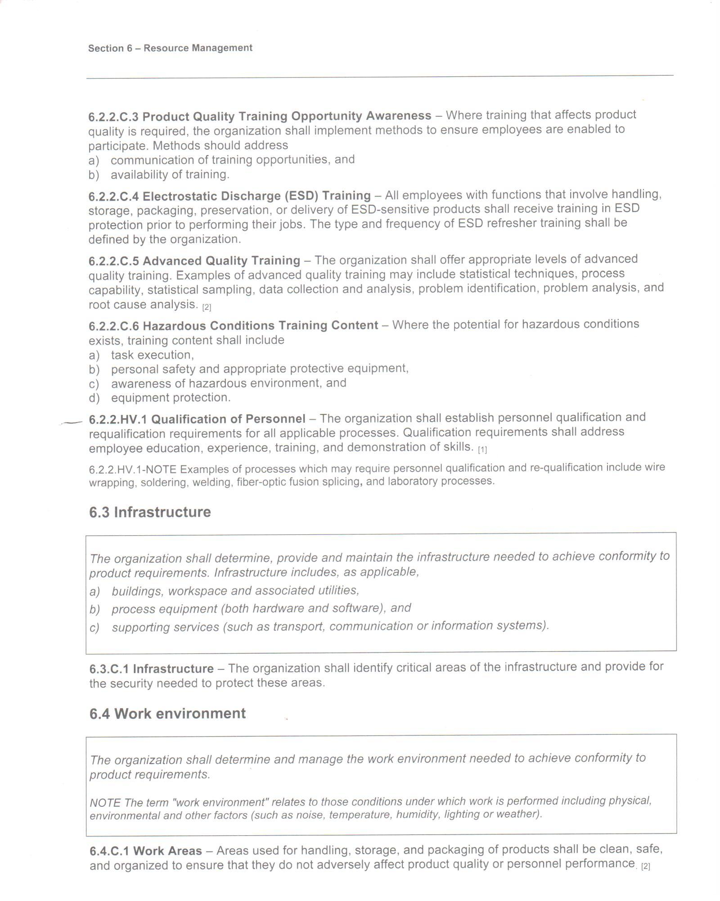
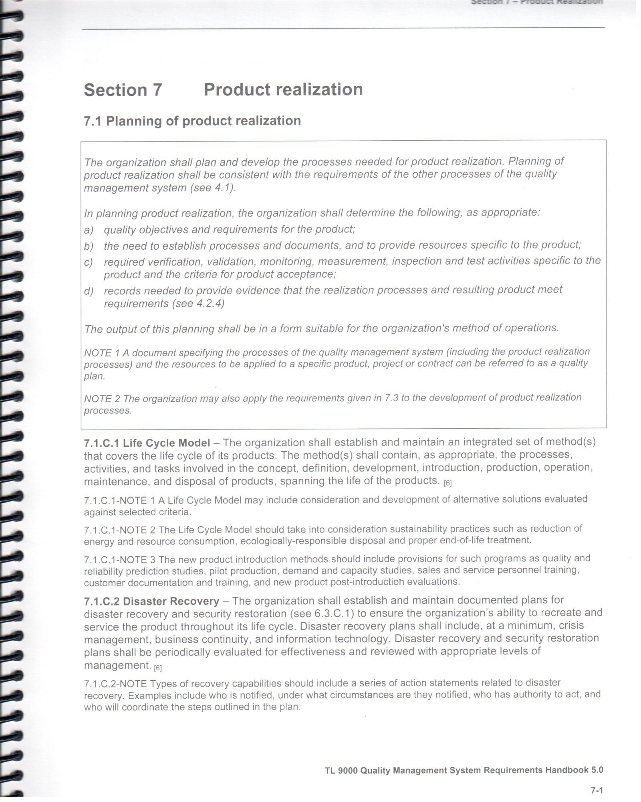
Refer to your printed copy of TL 9000 Pages 6-2 and 7-1

Slide 28
Key TL 9000 Requirements Overview (What TL 9000 Adds to ISO 9001)
R&D, PLM
Sales
Production
Other
Section 7.3
Sections 5.2, 5.4, 7.2, 8.2
Sections 7.4, 7.5, 8.2.3, 8.2.4
Sections 5 (all), 6 (all)
Expanded Design Requirements Specific to resolve Telecom Issues
Strategic Relationships, Contracts, Customer Satisfaction Measurement
Added Production and Test Requirements, Process and Supplier Management
Communications, Quality Planning, Training, Infrastructure, Disaster Recovery
Measurements Handbook: Industry Benchmarking for Problem Resolution, OTD, Product Quality, Service Quality, Software Quality, Outages

Slide 29
TL 9000 Requirements – Strategic Relationships
5.2.C.1 Customer Relationship Development – Top management shall demonstrate active involvement in establishing and maintaining mutually-beneficial relationships between the organization and its customers.
5.2.C.2 Customer Communication Methods – The organization shall establish and maintain methods for communicating with selected customers to share expectations and to ensure product quality improvement. The outcome of customer communication should generate actions for resolving identified issues and provide opportunities for improving customer satisfaction.
5.4.1.C.1 Quality Objectives – Objectives for quality shall include targets for the TL 9000 measurements defined in the TL 9000 Quality Management System Measurements Handbook.
5.4.2.C.1 Long- and Short-Term Quality Planning – The organization’s quality planning activities shall include long- and short-term plans with goals for improving quality and customer satisfaction. The plans shall address business factors relevant to the organization and its customers, including performance objectives established jointly with selected customers. Performance to these goals shall be monitored and reported to top management.

Slide 30
TL 9000 Requirements – Design
7.3.1.C.1 Project Plan – The organization's project planning activities shall be based on the defined product life cycle model (see 7.1.C.1). The project plan should include design for ‘x’ plans as appropriate to the product life cycle. Plan examples include, but are not limited to, Manufacturability, Reliability, Regulatory, Serviceability, Safety, Sustainability, and Testability
7.3.1.C.2 Requirements Traceability – The organization shall establish and maintain a method to trace documented requirements through design and test.
7.3.1.C.4 Risk Management Plan – The organization shall develop and document a plan for the identification, analysis, and control of risks to the project that can impact cost, schedule, product quality or product performance.
7.3.1.C.6 Estimation – The organization shall establish and maintain a method for estimating and tracking project factors against the project plan throughout the project life cycle.

Slide 31
TL 9000 Requirements – Data Analysis
8.2.1.C.1 Customer Satisfaction Data – The organization shall establish and maintain a method to collect data directly from customers concerning their satisfaction with provided products. The organization shall also collect customer data on how well the organization meets commitments and its responsiveness to customer feedback and needs. This data shall be analyzed and trended.
8.2.3.C.1 Process Measurement – Process measurements shall be identified, documented, and monitored at appropriate points to ensure continued suitability and promote increased effectiveness of processes. This includes the establishment of appropriate design process measurements. Key process measurements that impact conformity to product requirements should have specific performance targets or control limits established.
8.4.V.1 Service Performance Data – The quality management system shall include the collection and analysis of service performance data, which can be used to identify the cause and frequency of service failure. This information shall be provided to the appropriate organizations to foster continual improvement of the service

Slide 32
TL 9000 Requirements – Supply Chain
5.4.2.C.3 Supplier Input – The organization shall implement methods for soliciting and using supplier input for quality planning activities.
7.1.HS.1 Configuration Management Plan – The organization shall establish and maintain a configuration management plan, which should include; identification and scope of the configuration management activities, schedule for performing these activities, configuration management tools, configuration management methods and documented procedure(s), organizations and responsibilities assigned to them, level of required control for each configuration item, and point at which items are brought under configuration management.
7.4.1.C.2 Supplier Performance Management – The organization shall plan and perform supplier performance management and development activities so that suppliers are qualified to established criteria, evaluation results are considered during supplier selection activities, suppliers are periodically re-evaluated using established criteria, supplier quality performance is tracked and feedback is provided to suppliers to drive continual improvement, and for identified key suppliers, alignment toward conformity to TL 9000 requirements and measurements or other appropriate quality management systems for the supplier’s products occurs, with a preference toward TL 9000.

Slide 33
TL 9000 Measurements
Benchmarking for the Telecommunications Industry

Slide 34
TL 9000 Measurements: Measuring Quality from the Customer’s Perspective
TL 9000 requires monthly reporting of quality metrics from the customer’s perspective.
Measurements can be used for industry benchmarking.
Quality
Products and services fit for use, feature packed
Speed
On time delivery
Quick response to service needs
Cost
Best value for their money
How can we compare suppliers fairly?

Slide 35
Measuring Quality from the Customer’s Perspective
 | Quality | Speed
Customer’s Measures | Field Returns (FR) System Outages (SO) Software Fix Quality (SFQ) Number of Problem Reports (NPR) | On Time Delivery (OTD) On time completion of problem report responses (FRT, OFR)
Internal Measures | Same as above plus internal in-process measurements | Same as above plus internal in-process measurements
Customers measure and compare suppliers. Shared, measurable goals facilitate improvement.

Slide 36
What Measurements Are Required for TL 9000 Certification?
Common Measurements All Registered Organizations Must Report:
Number of Problem Reports Timeliness of Problem Resolution On Time Delivery
All certified companies MUST submit monthly data to QuEST Forum.
Data is used:
Internally for continual improvement
By customers to compare their suppliers and to drive improvement
By QuEST Forum for industry bench marking
Product and Service Quality Varies by Specialty and Product Category:
Field Replaceable Unit Returns Software Fix Quality Software Problem Reports System Outages Service Quality

Slide 37
How Can We Compare Companies Fairly?
Break out and report data for each Product Category in the scope of registration
Primary Product Categories
Test Equipment
Operational Support Systems (OSS)
Repair Service
Calibration
Tech Support
Installations
Report data according to the counting rules defined in the handbook
Normalize data (e.g., problems per unit shipped) so we can compare different sizes of companies
Audit each company’s defined processes for measurements collection, validation and reporting

Slide 38
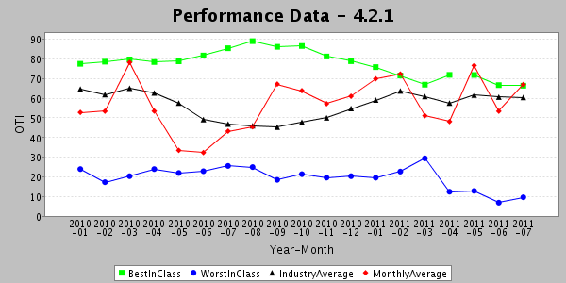
Operations Support Systems On time delivery benchmark data

Slide 39
Implementation Roadmap
The way to success

Slide 40
Proven Implementation Model
Understand TL 9000 and Customer Needs, Set Goals, Initial Gap Assessment, Commit Resources
Management Commitment
Organizational Preparation
Process Improvement
Assess and Review
Continual Improvement
Collect and Report TL 9000 Measurements (ongoing)
Core Team Selection and Training, Project Planning, Gap Assessment
Process Mapping, Documentation, Data Collection and Analysis, Process Changes to Meet New Requirements
Internal Audit, Management Review, Corrective and Preventive Action
External Assessment and Certification

Slide 41
Critical Path to Implementation
Management Commitment
Organizational Preparation
Process Improvement
Assess and Review
Continual Improvement
Business Imperative High Level Champion Adequate resources
Collect and Report TL 9000 Measurements (ongoing)
Core team with knowledge and authority: Success tied to annual objectives
Build on a strong ISO 9001 system (or allow time for remediation)
Competent Auditors Effective Corrective Action Management Attention to Effectiveness
Early Registrar Selection and Planning
External Assessment and Certification

Slide 42









How successful is this model
Basis for QF Sanctioned Implementation Training
Typically 12-24 months
Scalable to organizations of all sizes

Slide 43
CommTest BMS Implementation Roadmap
Understand TL 9000 and Customer Needs, Set Goals, Initial Gap Assessment, Commit Resources
Management Commitment
Organizational Preparation
Process Improvement
Assess and Review
Continual Improvement
7/11 – 8/11
Collect and Report TL 9000 Measurements (ongoing)
Core Team Selection and Training, Project Planning, Gap Assessment
9/11-10/11
Process Mapping, Documentation, Data Collection and Analysis, Process Changes to Meet New Requirements
11/11-8/12
Internal Audit, Management Review, Corrective and Preventive Action
6/12-11/13
10/12-1/13
Permanent
External Assessment and Certification
Q3 ‘13 +

Slide 44
BMS Implementation Structure
Internal Audit Team (Functional Reps)
Plan, conduct, report, and verify closure of internal audits
Verify compliance with requirements
Evaluate effectiveness of processes
Identify opportunities for process improvement
Highlight weaknesses in cross functional alignment
Provide reports to SMT and Process Teams
CommTest Executive Leadership
(SMT)
Define CommTest TL9000 deployment scope and align to Business Objectives
Set performance objectives & targets for measurements (KPIs)
Establish and continually drive effective communication plan
Drive accountability across CT for quality, execution and results
Own action plans to address and close gaps
Quality Team
Champion Compliance with ISO9001 & TL9000 Requirements
Drive the development of the overall business process architecture
Provide tools, expertise & training in process definition, mapping, improvement & change management
Alignment &
Support
BMS Core Team
(Process Owners, Functional Reps)
Ensure key processes are identified within the context of TL9000 architecture
Create plan for design, improvement and implementation of core business processes
Hands-on champions to drive mapping and improvement of CT business processes
Develop, maintain & evaluate process metrics for core business processes
Remove obstacles to success, ensure organizational support for the project
Recommended changes to SMT regarding CT policies, procedures & operations
Execute steering activities to guide and support effective BMS implementation across the division
Process Design/
Implementation
Improvements
Process
Accountability &
Oversight
Cross Functional Process Teams
(Stakeholders, SMEs)
Plan, develop, document new business processes based on common/best practices
Identify organizational impact issues and mitigation plans
Document standard operating procedures and other required docs
Establish and execute implementation plans/document and report results

Slide 45
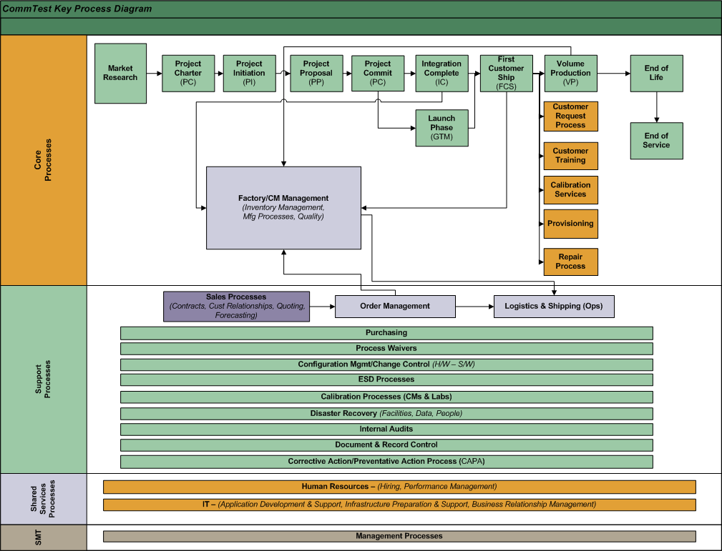


CommTest Process Interaction Diagram (PID)

Slide 46

Process Owners Responsibilities
CommTest Process Owner Responsibilities
Operational Accountability
Measurement Accountability
CAPA Role
Audit Role
Process Waiver Role

Slide 47
BMS - Typical Resource Commitments
Executive
Champion
Weekly monitoring, attend critical meetings, remove of roadblocks
Project
Manager
Major project, 40-50+% time commitment depending on scope of project and organizational maturity
TL 9000
Measurements Owners
Major commitment up front; permanent monthly commitment
Process
Owners
~20% up front commitment to develop/implement processes & measures
All
Employees
Awareness training (1-4 hours per person)
Participation in improvement teams within own area (key people)
Receive and implement job specific training (varies)
Internal
Auditors
Training
On going CAPA role and audit support
Plan, Perform, Report, and Verify quarterly internal audits
10 man-days per quarter across selected team

Slide 48
BMS Core Team

Slide 49
Next Steps
Concurrence to move forward with the Project - TODAY!
Kick off Meeting with BMS Core Team – November 1st-3rd
Detailed review of TL9000 standard & requirements
Overview /discussion of TL9000 measurement & system requirements
Present plan to implement a TL9000 compliant Business Management System (BMS) at CommTest
Identify core business processes and conduct gap analysis
Define and agree on CommTest’s process owners and responsibilities
Launch Process Development Activities
PDP Process mapping underway – continue with PDP Gates – November 2011
Process mapping for all core/support processes – commence in January 2012
Begin TL 9000 Measurement Development – January 2012

Slide 50

Discussion

Slide 51
Tl 9000 certification
External Verification of Compliance
Potential Benefit to Telecommunications Industry Sales
Business Decision as to the Value

Slide 52
TL 9000 Certification: Plan Dates & Steps
Establish and Maintain Compliance
Certification Requirements
Establish a Business Management System that complies with TL 9000
Perform internal audits and verify effectiveness
Submit monthly performance data to QuEST Forum
Demonstrate compliance to an Accredited Registrar (Registration Audit)
Maintain and improve the system
Nov 2011-Aug 2012
Jun 2012-Nov 2013
Oct 2012-Jan 2013
Jun 2012-Nov 2013
Jan 2014-Mar 2014
Certified
Note: Registrars are required to conduct annual surveillance audits.

Slide 53
TL 9000 Certification: Roles
Organization
Establish a system that meets TL 9000 requirements
Registrar (Certification Body – CB)
Evaluate (audit) Organizations against TL 9000
Accreditation Body (AB)
Ensure credibility of Registrars through oversight of against AB and QuEST Forum criteria
QuEST Forum
Establish TL 9000 and requirements for Accreditation Bodies and Registrars
Data Submission
Certifies
Accredits
Authorizes
Customers
May consider TL 9000 in supplier selection and evaluation
May audit/evaluate suppliers, but TL 9000 certification is intended to reduce the need.
May request (require) disclosure of TL 9000 measurements

Slide 54
The DESARA Group
Dave Sanicola Certified TL 9000 Expert Dave.Sanicola@DesaraGroup.com Supervisory Master Trainer (631) 909-1085
Karen Rawson Certified TL 9000 Expert Karen.Rawson@DesaraGroup.com Past Master Trainer (469) 293-6232
Main Office QuEST Forum Member www.DesaraGroup.com Active Since 1999 (631) 909-3570 Hampton Bays, New York

